Slide 1
Project 1
Nicole Nanton, Clinton Waters, Kasa Ftwy, Jorge Torres, Nell Meier

Slide 2
Netflix Vs. Hulu
Which streaming service provider is top dog?
Example questions:
Who has the biggest subscriber base?
Who has the biggest offering?
Who has the most original content?
However…
Both streaming services stopped offering an API, only pypi’s
We were unable to find a reliable data source

Slide 3
Yelp API Sample Questions
How often do chain restaurants show up?
Which city has the highest concentration of popular chain restaurants?
What is the relationship between average review and review count?
What are the top 5 popular foods based on number of ratings?
What are the top 5 least popular foods based on number of ratings?
What is the most popular cuisine based on ratings by individual city?

Slide 4
Finding the Data
Yelp API - limitations
Can only make 5000 calls per day
Requires authentication with a Bari token
Can only return 50 records at once
Postman
Allowed us to test the

Slide 5
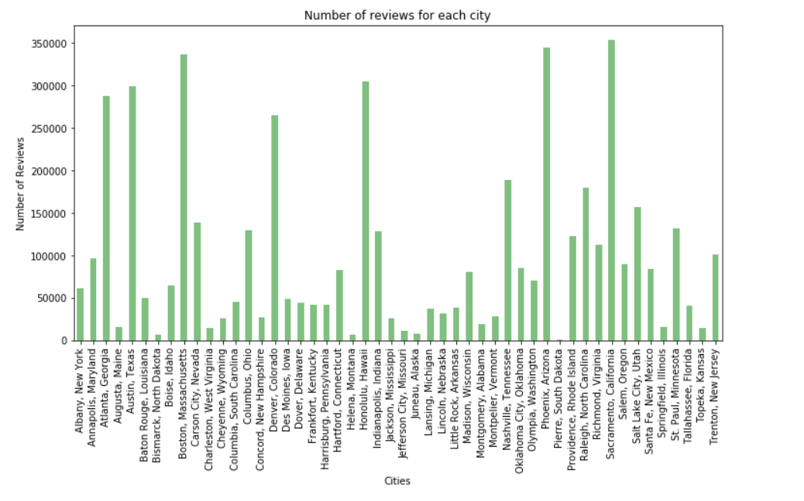
Number of Reviews for Each City

Slide 6
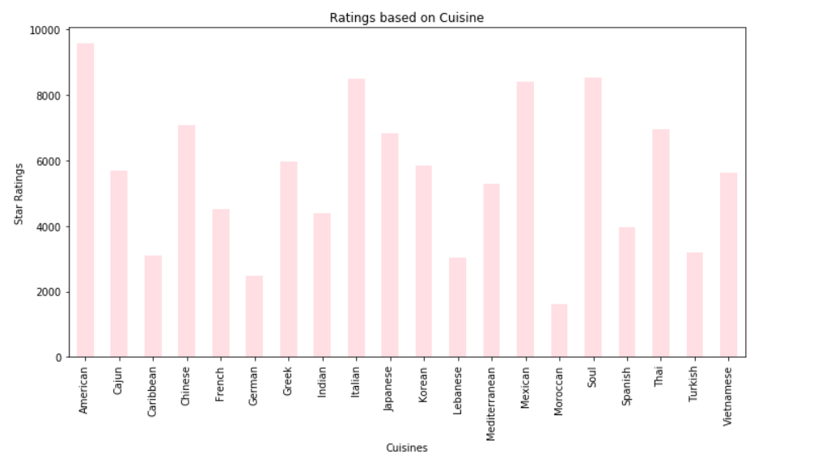
Number of Ratings Based on Cuisine

Slide 7
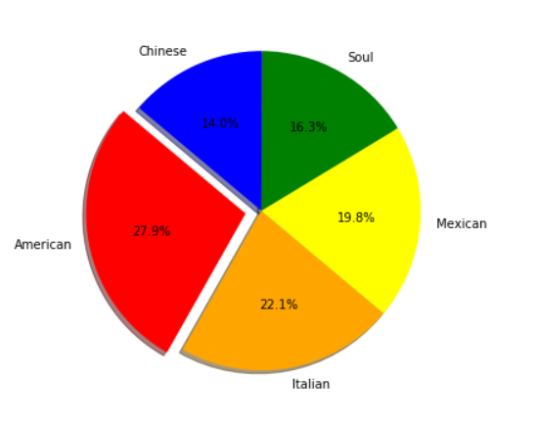
Top Five Most Popular Cuisines

Slide 8
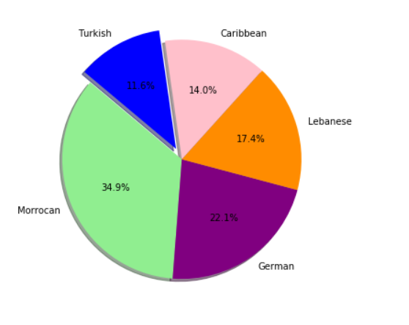
Least Five Popular Cuisines

Slide 9
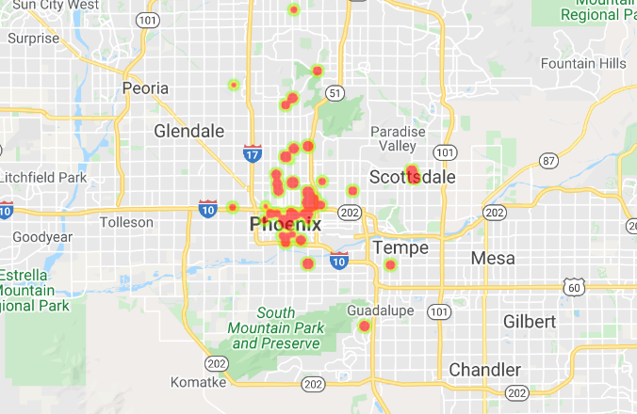
Heat Map of Restaurants in Phoenix, AZ

Slide 10
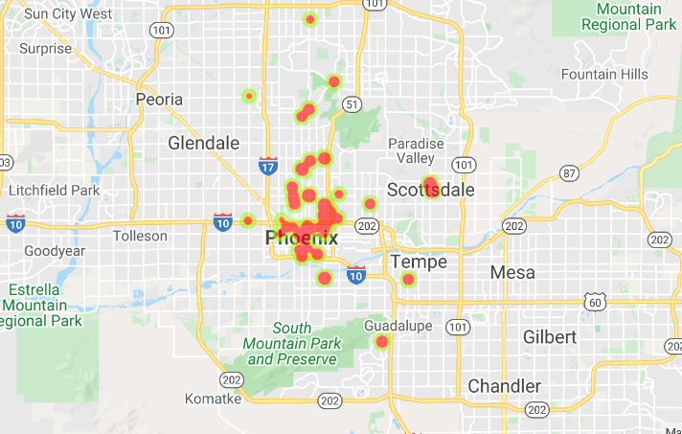
Heatmap of Mexican Restaurants in Phoenix, AZ

Slide 11
Conclusions

Slide 12
Top Conclusions from D

Slide 13
Next Steps

